Slide 1
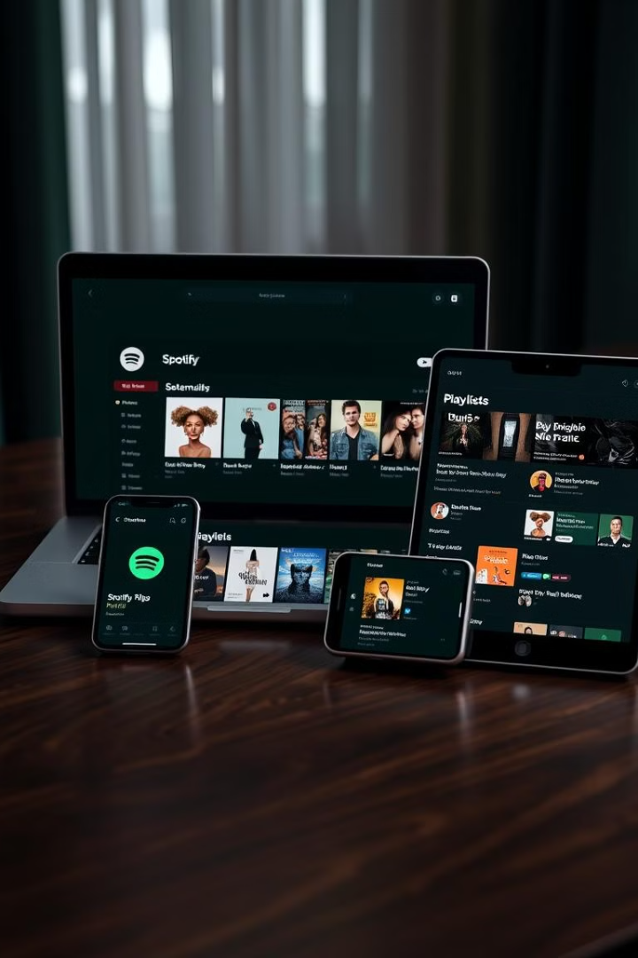
Spotify Clone
This is a clone of the popular music streaming platform Spotify, aiming to replicate its core features and user experience. The project focuses on frontend development, utilizing HTML and CSS to create a functional interface that mimics Spotify's look and feel. Key sections include a sidebar for navigation, a main content area for music browsing, and player controls for playback management.
The clone showcases fundamental web design principles while delivering an intuitive user interface. It includes features such as music browsing, playlist display, and album details, all designed to provide a visually appealing representation of a music streaming platform.

Slide 2
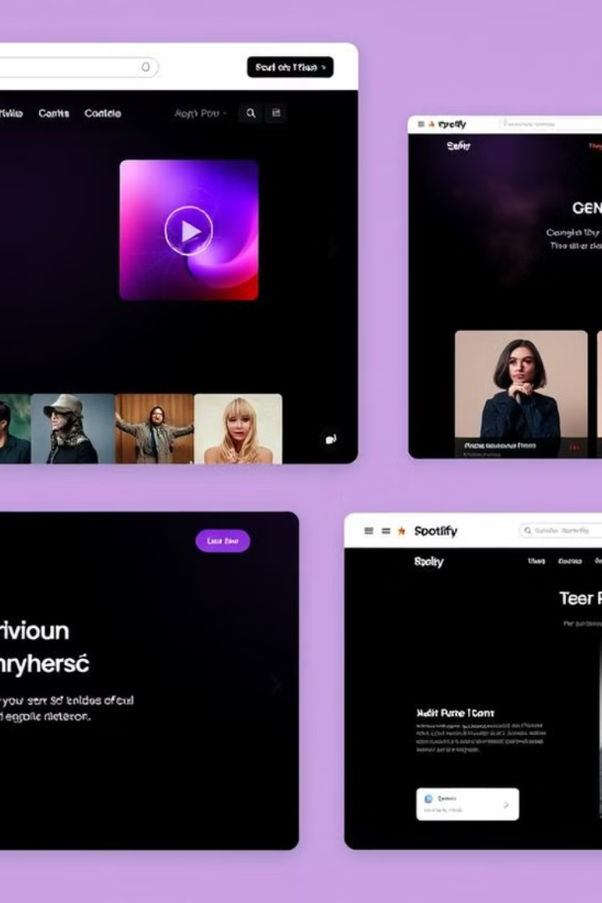
HTML Structure
1
Sidebar
Contains navigation options like Home, Search, and Library. Includes links and icons for easy access to main sections.
2
Main Content Area
Features a navigation bar, recently played section, and displays for albums, playlists, and featured charts.
3
Player Controls
Located at the bottom, includes playback controls and currently playing song information.

Slide 3
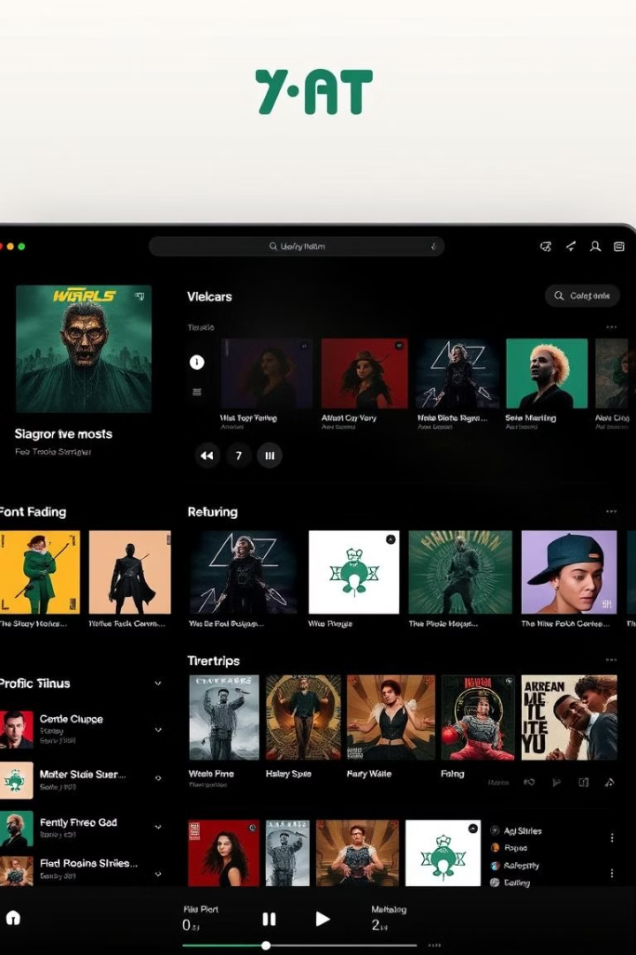
CSS Styling
Uses flexbox for overall layout. Main content takes remaining space. Fixed position for music player at bottom.
Dark theme with black background. White text for contrast. Uses Montserrat font family.
Media queries for smaller screens. Hides certain elements when width is below 1000px.

Slide 4
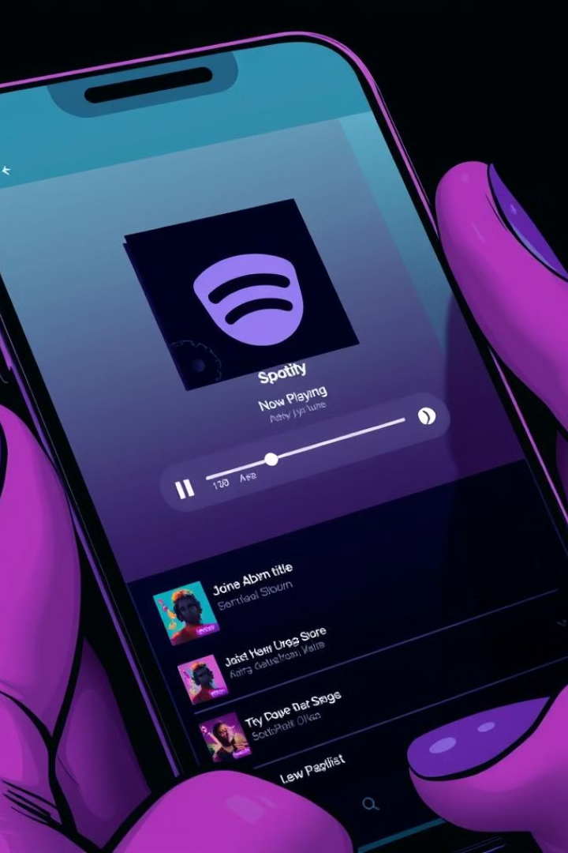
Features
1
Sidebar Navigation
Left-side sidebar with Home, Search, and Library options. Includes playlist creation and podcast discovery features.
2
Main Content Display
Sticky navigation bar with install and premium options. Sections for recently played, trending songs, and featured charts.
3
Music Player Controls
Bottom-fixed player with basic playback controls and currently playing song display.

Slide 5
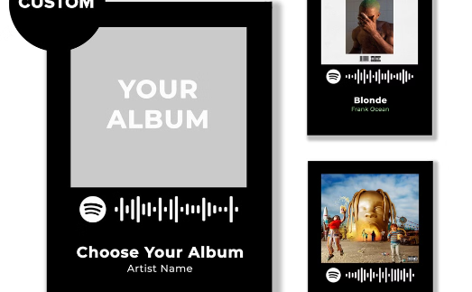
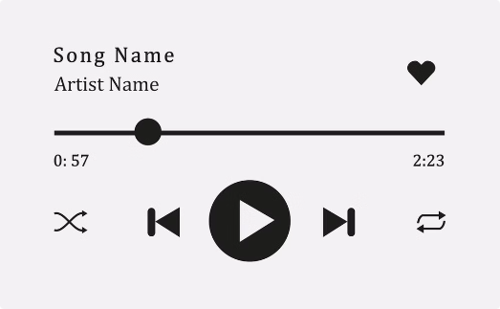
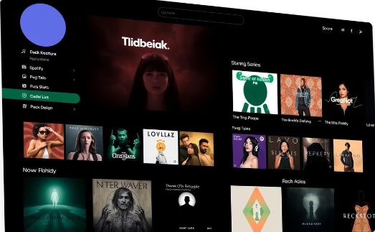
Visual Elements
Album Covers
Player Icons
Overall Interface
Displays album artwork for various artists and playlists, enhancing visual appeal and user recognition.
Intuitive icons for play, pause, skip, and other playback controls, ensuring easy navigation of music.
Clean, modern design with a dark theme, emphasizing content and maintaining Spotify's signature look and feel.

